Slide 1

TootingTrumpets
Pinelands Music School
Nicholas Gaffney
Yu Gen Yeap
Jayden Dao
Tim Jebsen

Slide 2

Why Google Cloud Services?
Tons of Online support
Guaranteed 99.7% Uptime
Cheap
Scalable
Pay for what you use
Running Virtual Machines for total control

Slide 3
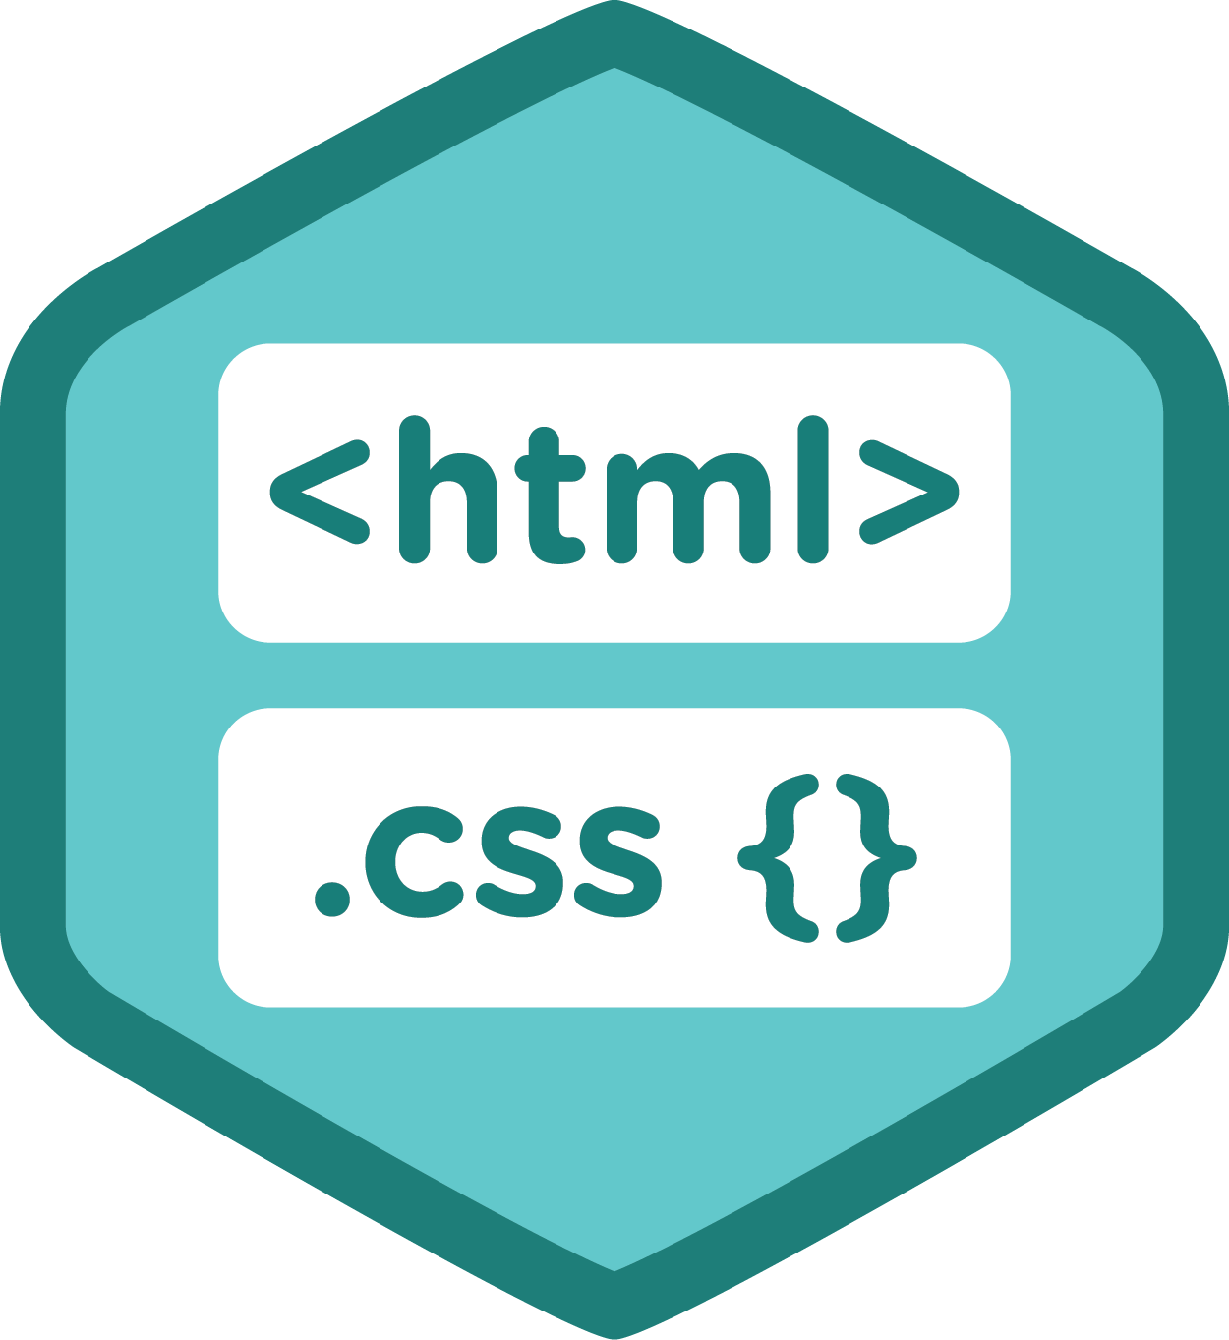





Why PHP/JS/HTML/CSS - Apache2/MySQL/PHPmyadmin?
Again, tons of online support
Very widely supported by almost every browser *IE with some limited functionality
All web developers are familiar with these to some extent.
Considered Industry Standard

Slide 4
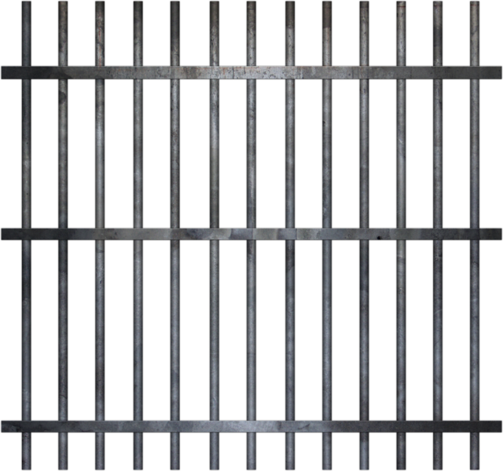



Why not WordPress, Joomla, Drupal, etc…?
Limited amount of control and customizability.

Slide 5
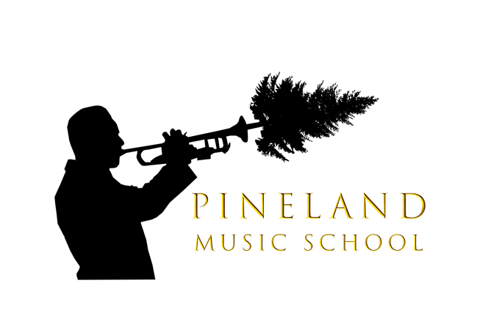
Logo Design
Directed to a prestigious audience

Slide 6
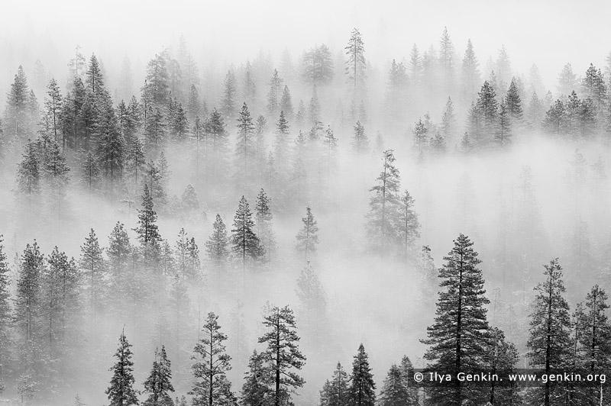

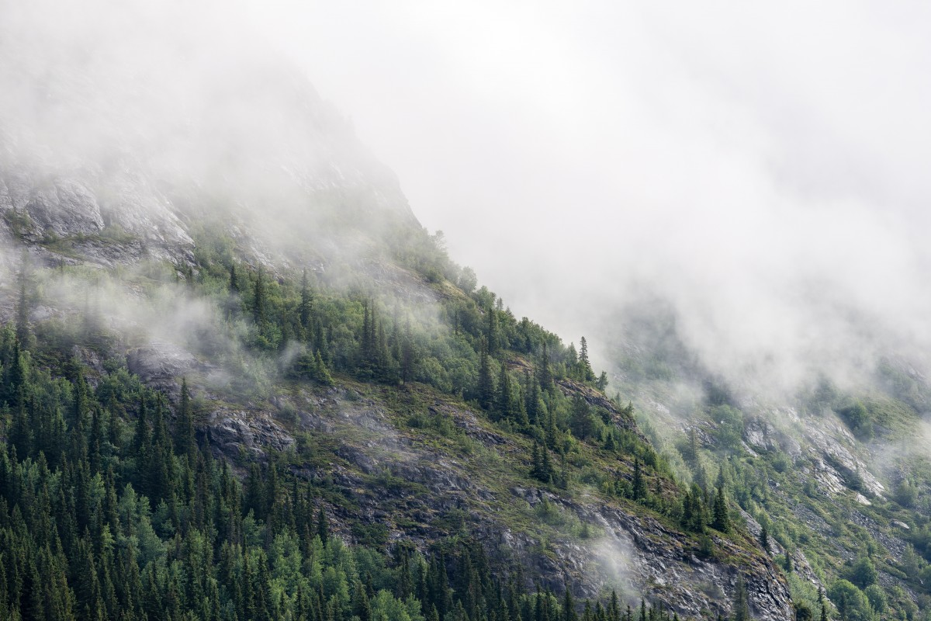

Background /Wallpaper design
Aesthetics draw upon textures of pine trees

Slide 7
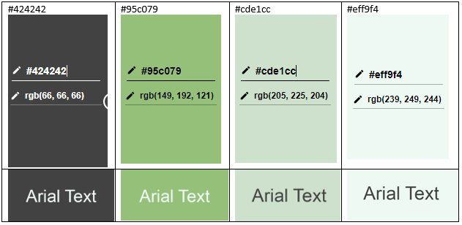


Colour style
Colours:
Buttons:
Green colour choices to represent trees
Evoke certain emotions within the user, providing a full wholesome user experience.

Slide 8
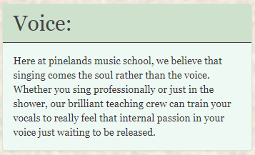
Text Style
Simple & Clear to read text choices (Times New Roman)
Intuitive design and workflow

Slide 9
Live Demo
Tootingtrumpets.me

Slide 10
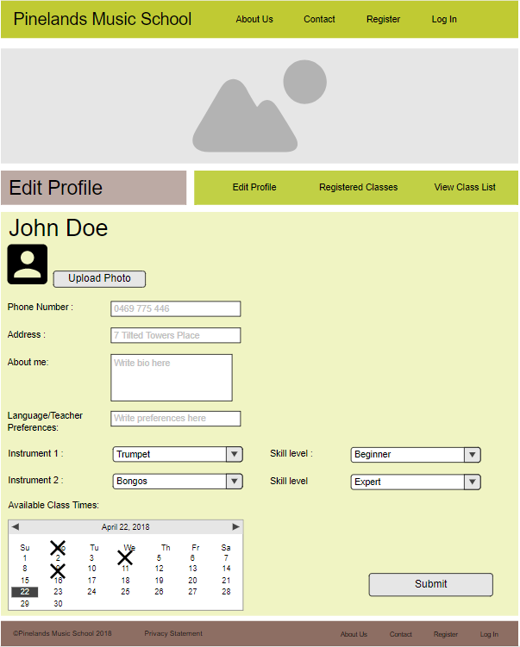
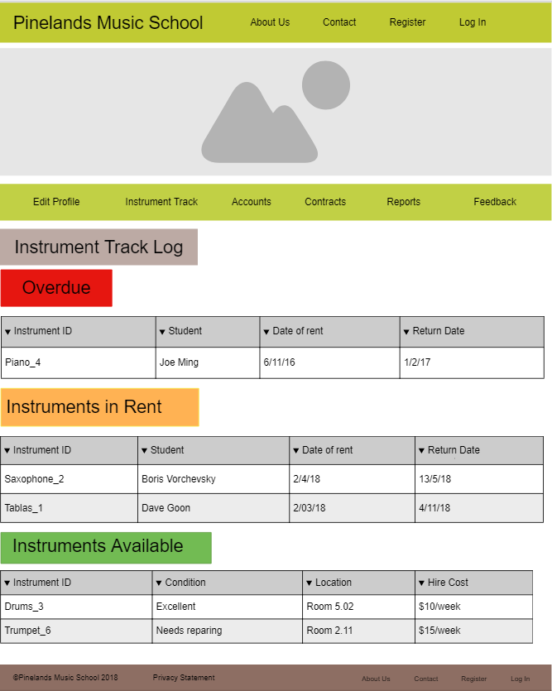
Coming Features

Slide 11
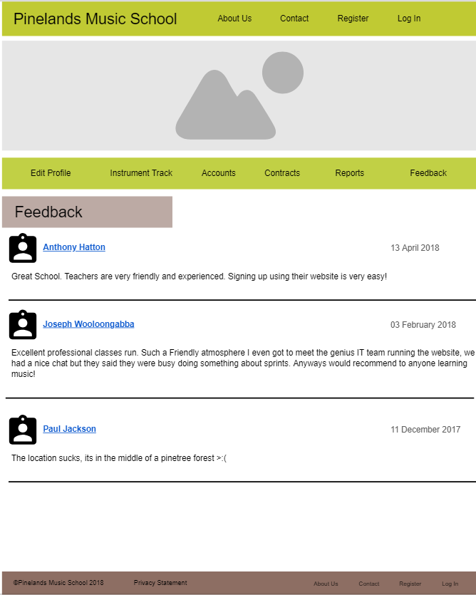
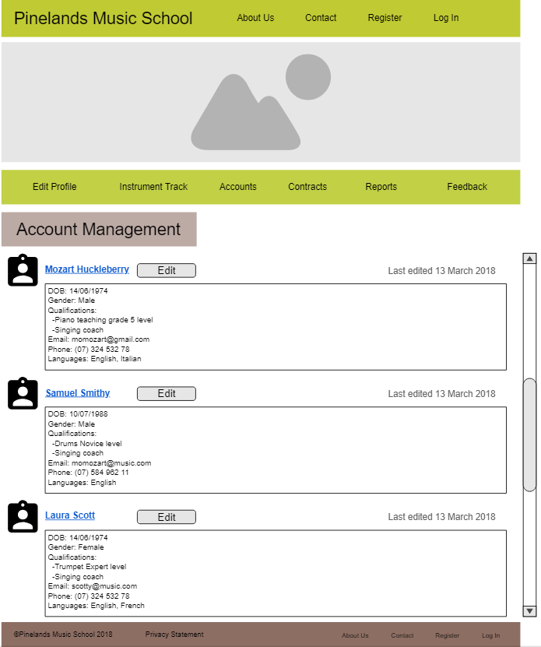
Coming Features

Slide 12
Questions?

